Slide 1

Doubly Linked List
Data Structure | Introduction to Data Structure
Course: Data Structure | Chapter: Introduction to Data Structure | Program: Bachelor of Engineering
DISCOVER · LEARN · EMPOWER
Notes:
Welcome everyone to today's lecture on Data Structures. We are focusing on the Introduction to Data Structure chapter. Today we will dive deep into the Doubly Linked List, a fundamental concept for your engineering journey. Remember our motto: Discover. Learn. Empower.

Slide 2
Course Outcomes
SLIDE 2 / 10
Course Outcome
CO | BT LEVEL | DESCRIPTION
CO1 | BT1 | Understand and apply basic data structures, algorithms, complexity analysis, ADTs, arrays and linked lists.
CO2 | BT2 | Apply and implement stacks and queues in problem-solving.
CO3 | BT3 | Analyse and apply searching, sorting, and hashing techniques.
CO4 | BT4 | Construct and apply tree structures and traversal techniques.
CO5 | BT5 | Represent and solve graph problems using DFS, BFS, and graph algorithms.
Chandigarh University
2 / 10
Notes:
This lecture directly supports our Course Outcomes. CO2 requires you to apply and implement stacks and queues in problem-solving, which builds on linked list logic. CO3 asks you to analyse and apply searching, sorting, and hashing techniques, where efficient traversal is key. Understanding this structure is the foundation for both outcomes.

Slide 3
Learning Objectives
SLIDE 3 / 10
Learning Outcomes
1
Define the structure and components of a Doubly Linked List.
2
Differentiate between singly and doubly linked list memory layouts.
3
Implement insertion and deletion algorithms for bidirectional traversal.
4
Analyze the time complexity of operations on this structure.
Chandigarh University
3 / 10
Notes:
By the end of this session, you will be able to define the structure and components of a Doubly Linked List. You will differentiate between singly and doubly linked list memory layouts to understand the trade-offs. We will also implement insertion and deletion algorithms for bidirectional traversal. Finally, you will analyze the time complexity of operations on this structure.

Slide 4
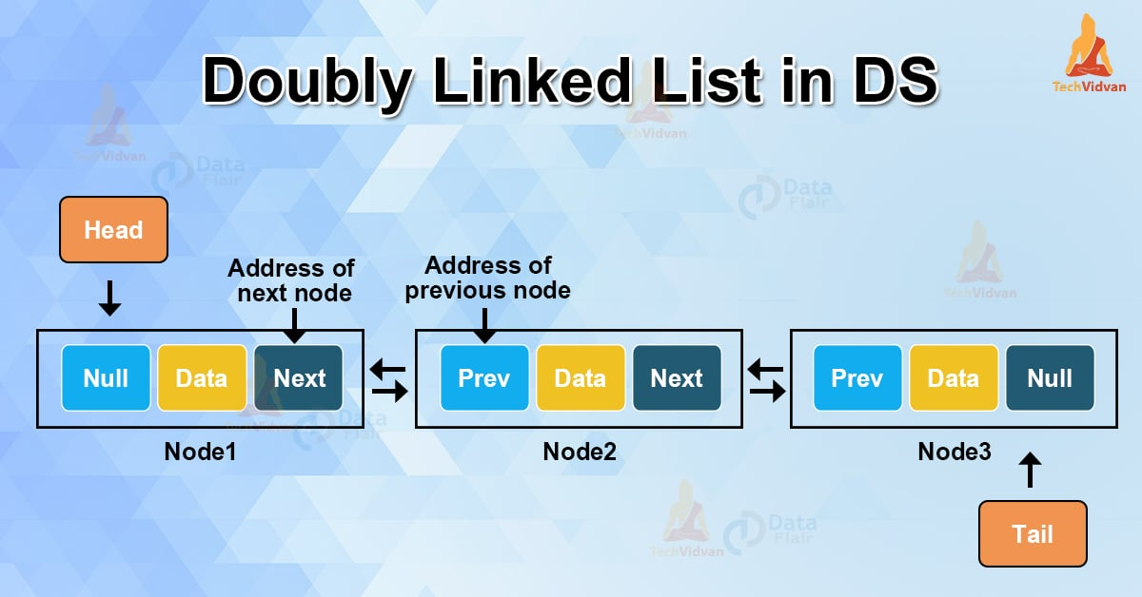
Lecture
SLIDE 4 / 10
Definition and Node Structure
EACH NODE CONTAINS THREE PARTS
data, a pointer to the next node, and a pointer to the previous node.
• A Doubly Linked List allows traversal in both forward and backward directions.
• The first node is called the head, and the last node is called the tail.
• The tail's next pointer and head's previous pointer are set to NULL.
• This structure enables efficient bidirectional movement compared to singly linked lists.
Doubly Linked List in Data Structure - TechVidvan
Chandigarh University
4 / 10
Notes:
Think of a Doubly Linked List as a chain where every link has a front and a back. Each node contains three parts: data, a pointer to the next node, and a pointer to the previous node. The first node is called the head, and the last node is called the tail. The tail's next pointer and head's previous pointer are set to NULL to mark the ends.

Slide 5
Lecture
SLIDE 5 / 10
Memory Layout and Pointers
1
Memory allocation for nodes is non-contiguous, similar to singly linked lists.
2
The prev pointer in the current node points to the immediate predecessor in memory.
3
The next pointer in the current node points to the immediate successor in memory.
4
Traversing backwards requires following the prev pointer from the tail node.
5
This bidirectional linking increases memory usage by one pointer per node.
Chandigarh University
5 / 10
Notes:
Memory allocation for nodes is non-contiguous, similar to singly linked lists. The prev pointer in the current node points to the immediate predecessor in memory. The next pointer in the current node points to the immediate successor in memory. Traversing backwards requires following the prev pointer from the tail node, which increases memory usage by one pointer per node.

Slide 6
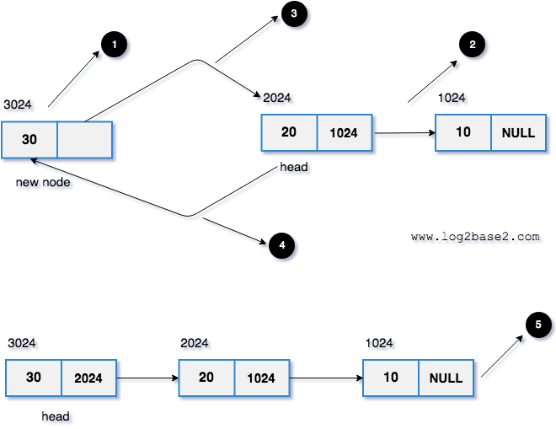
Lecture
SLIDE 6 / 10
Insertion at the Beginning
1
Create a new node and assign the data value to be inserted.
2
Set the new node's next pointer to the current head of the list.
3
If the list is not empty, set the current head's prev pointer to the new node.
4
Update the head pointer to point to the new node as the new start.
5
If the list was empty, set the tail pointer to the new node as well.
Source: www.log2base2.com
Chandigarh University
6 / 10
Notes:
To insert at the beginning, create a new node and assign the data value to be inserted. Set the new node's next pointer to the current head of the list. If the list is not empty, set the current head's prev pointer to the new node. Update the head pointer to point to the new node as the new start.

Slide 7
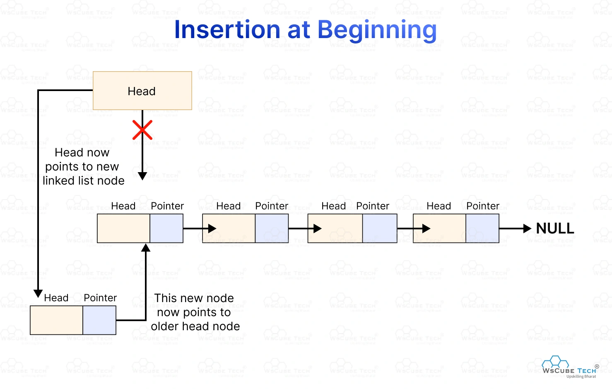
Lecture
SLIDE 7 / 10
Insertion at the End
1
Create a new node and assign the data value to be inserted.
2
Set the new node's prev pointer to the current tail of the list.
3
If the list is not empty, set the current tail's next pointer to the new node.
4
Update the tail pointer to point to the new node as the new end.
5
If the list was empty, set both head and tail pointers to the new node.
Source: deen3evddmddt.cloudfront.net
Chandigarh University
7 / 10
Notes:
To insert at the end, create a new node and assign the data value to be inserted. Set the new node's prev pointer to the current tail of the list. If the list is not empty, set the current tail's next pointer to the new node. Update the tail pointer to point to the new node as the new end.

Slide 8
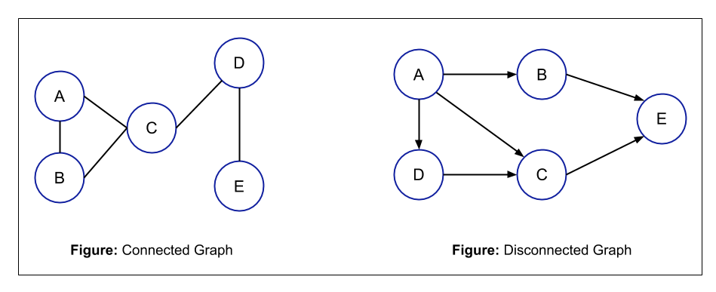
Lecture
SLIDE 8 / 10
Deletion of a Node
1
Locate the node to be deleted by traversing the list.
2
Update the next pointer of the previous node to skip the target node.
3
Update the prev pointer of the next node to skip the target node.
4
If the target is the head, update the head pointer to the next node.
5
If the target is the tail, update the tail pointer to the previous node.
Source: static.afteracademy.com
Chandigarh University
8 / 10
Notes:
To delete a node, locate the node to be deleted by traversing the list. Update the next pointer of the previous node to skip the target node. Update the prev pointer of the next node to skip the target node. If the target is the head, update the head pointer to the next node.

Slide 9
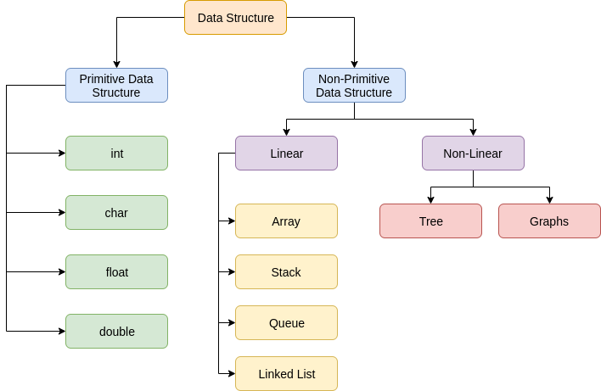
Lecture
SLIDE 9 / 10
Key Takeaways
1
Doubly Linked Lists support bidirectional traversal using prev and next pointers.
2
Each node requires extra memory for the additional previous pointer.
3
Insertion and deletion are efficient but require careful pointer manipulation.
4
The structure is ideal for applications requiring frequent backward movement.
5
Time complexity for basic operations remains O(n) for traversal.
Source: static.afteracademy.com
Chandigarh University
9 / 10
Notes:
Doubly Linked Lists support bidirectional traversal using prev and next pointers. Each node requires extra memory for the additional previous pointer. Insertion and deletion are efficient but require careful pointer manipulation. The structure is ideal for applications requiring frequent backward movement.

Slide 10
Lecture
SLIDE 10 / 10
References
DATA STRUCTURES
A Pseudocode Approach with C — Gilberg, Forouzan
• Data Structures — Lipschutz
• Data Structure Using C — AK Sharma
• C and Data structure — P. S. Deshpandey
Chandigarh University
10 / 10
Notes:
For further reading, please refer to Data Structures: A Pseudocode Approach with C by Gilberg and Forouzan. You may also consult Data Structures by Lipschutz for additional examples. Data Structure Using C by AK Sharma is another excellent resource. Finally, C and Data structure by P. S. Deshpandey provides comprehensive coverage.

